Slide 1
Human-level control through deep reinforcement learning
Thierry Deruyttere & Armin Halilovic

Slide 2
Overview
Introduction
Reinforcement learning
Deep learning
Deep reinforcement learning
Demo!
What may be next
Notes:
Introduction legt uit wat de problem statement is en gaat over naar de aanpak die we gaan uitleggen
Hernoemd naar introduction: What is the problem we want to solve? & How can we do this?

Slide 3
Introduction - Problem statement
We want to create an agent that can:
learn to solve a problem
with human-level performance
without any human interference
Notes:
Formerly: What is the problem we want to solve?
Without any human interference => no one actively helping the agent solve the problem, no examples of how to solve the problem

Slide 4
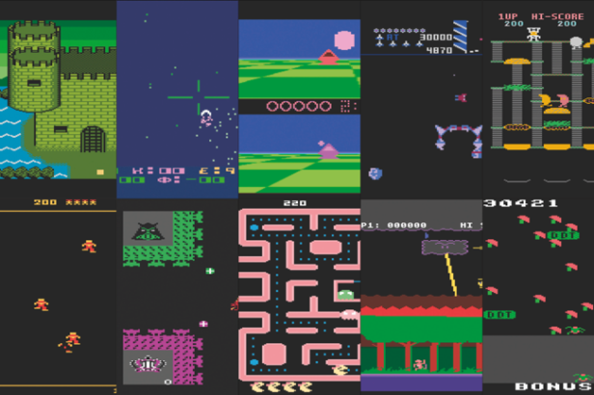
Introduction - Problem statement
retrogamer.net/top_10/top-ten-atari-2600-games

Slide 5
Introduction - An approach
A combination of:
Reinforcement learning
Deep learning
Deep reinforcement learning!
Notes:
Formerly: How can you do this?
A possible solution to this problem is using (deep) reinforcement learning!
But how does it work?
Misschien hier ook zeggen dat we zullen uitleggen waarom je niet gewoon reinforcement learning of deep learning apart kan doen? Deep learning i guess wel maar dat je het beter doet met deep reinforcement voor performance?

Slide 6
Reinforcement learning

Slide 7
Reinforcement learning
We want to create an agent that:
given a state s (e.g: lives left, current pos, pos of enemies, …)
returns an action a (e.g: move left, move right, fire, …)
gets a reward r for that action (from environment)
Agent’s goal:
learn a policy π that will maximise the sum of rewards
π = function that says which action a to take in state s
Notes:
http://incompleteideas.net/book/ebook/node29.html
We want to create an agent that given a state s returns an action a and for every action the agent should get a reward r to know how good that move was.
The goal of the agent should be to choose actions according to some kind of function (policy) that maximises the rewards it gets over a certain period T.
=> Should not only increase the reward on a certain time t but over a period T
Bij het zeggen van de agent’s goal: this does not mean that the reward r is maximal for every action a, just that the sum of rewards during T have to be maximised

Slide 8
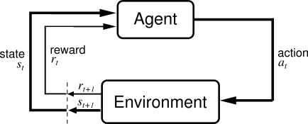
Reinforcement learning (visual)
Richard Sutton and Andrew Barto, Reinforcement Learning: An Introduction (1st Edition, 1998)
Notes:
Richard Sutton and Andrew Barto, Reinforcement Learning: An Introduction (1st Edition, 1998)

Slide 9
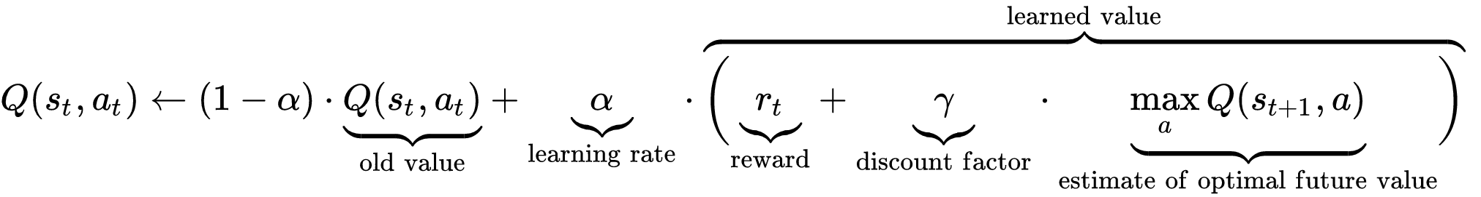
Reinforcement learning - Q-learning
Model-free method to compute the optimal policy π
Iterative improvement
Implemented using tables or neural networks (function approximation)
wikipedia.org/wiki/Q-learning
Notes:
Model free = able to compare the expected utility of the available actions (for a given state) without requiring a model of the environment.
Q-learning at its simplest uses tables to store data. This approach falters with increasing sizes of state/action space of the system.
Function approximation
One solution is to use an (adapted) artificial neural network as a function approximator.[8]
More generally, Q-learning can be combined with function approximation.[9] This makes it possible to apply the algorithm to larger problems, even when the state space is continuous. Additionally, it may speed up learning in finite problems, due to the fact that the algorithm can generalize earlier experiences to previously unseen states.

Slide 10
Deep learning

Slide 11
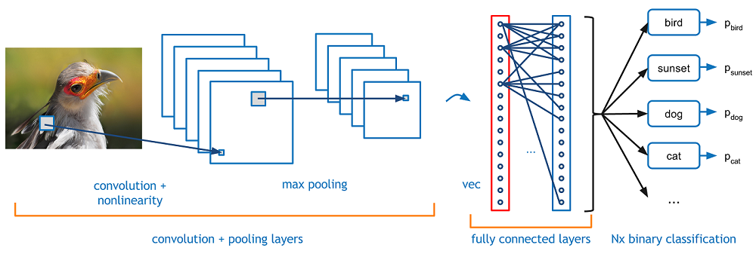
Deep learning - CNN
Maps image to class probabilities
Classification example: return the likeliest category for this picture
adeshpande3.github.io/A-Beginner's-Guide-To-Understanding-Convolutional-Neural-Networks
Notes:
Hier vermelden dat we hier CNNs gaan bespreken wat maar een deel is van deep learning maar hetgeen is dat we gaan gebruiken?

Slide 12
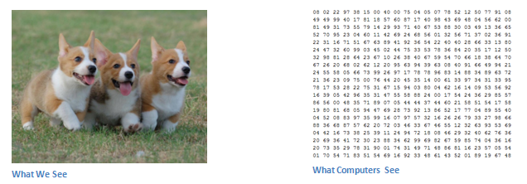
CNN - How it’s done
adeshpande3.github.io/A-Beginner's-Guide-To-Understanding-Convolutional-Neural-Networks
Notes:
Formerly: CNN - How is it done?

Slide 13
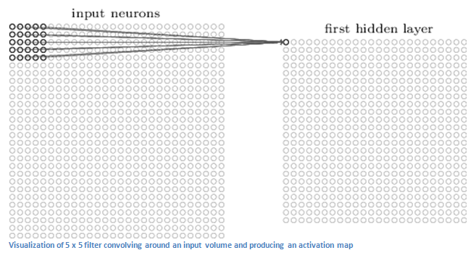
CNN - Convolution
http://neuralnetworksanddeeplearning.com/images/tikz44.png
Notes:
Formerly: How is it done (convolution)
Compressing data

Slide 14
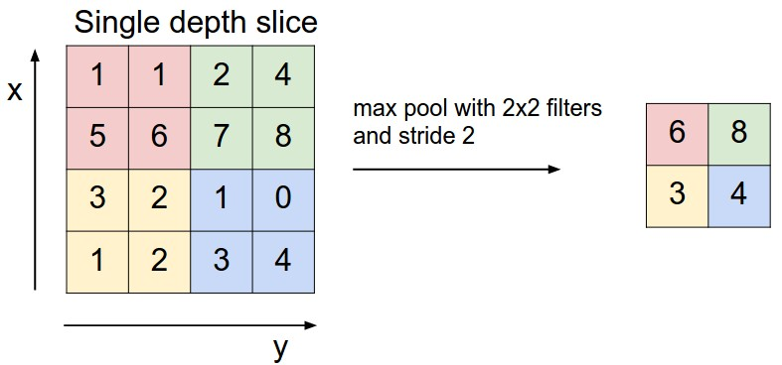
CNN - Max pooling
http://cs231n.github.io/convolutional-networks/

Slide 15
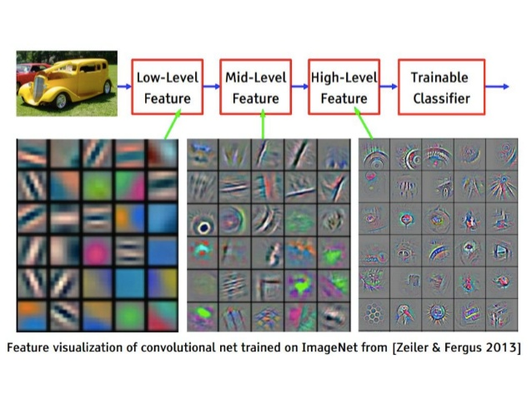
CNN - What it sees
Stack convolutional layers and then stack a classifier on top to predict the class

Slide 16
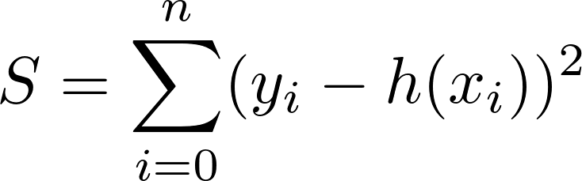
CNN - How to train it (loss function)
Input: image x_i with known class y_i
Output: prediction h(x_i)
Loss: distance metric between real class y_i and output h(x_i)
Example loss function:
adeshpande3.github.io/A-Beginner's-Guide-To-Understanding-Convolutional-Neural-Networks

Slide 17
Deep reinforcement learning

Slide 18
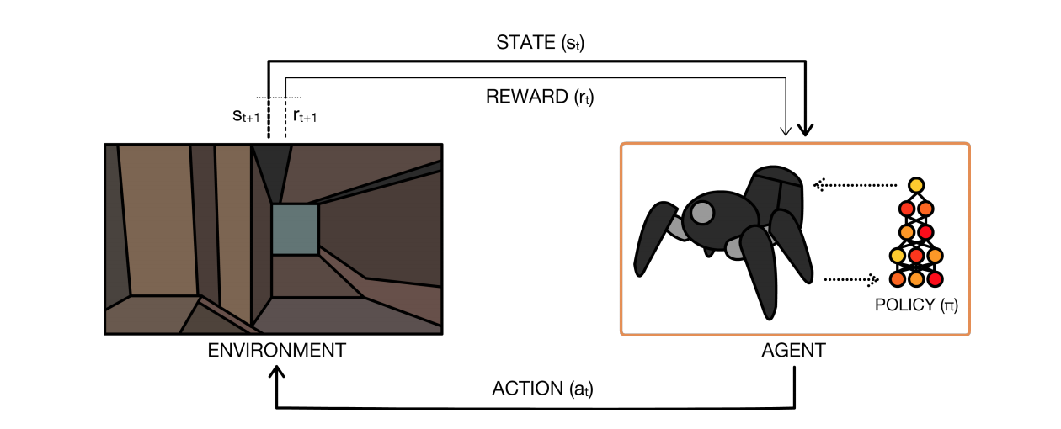
Deep reinforcement learning (DRL)
Combination of reinforcement learning and deep learning!
We introduce the concept using Deepmind’s Deep Q-Network (DQN).
A Brief Survey of Deep Reinforcement Learning, arXiv:1708.05866
Notes:
We will introduce the concept of deep reinforcement learning by Deepmind’s Deep Q-Network. There are many ways to do DRL, but this is the most popular one. Later on, we will touch on some other methods.

Slide 19
Why combine RL with DL
Traditional RL agents perform well in a variety of specific domains (robot soccer, games, …) but it has drawbacks:
Feature extraction (by hand)
Not scalable (curse of dimensionality)
Cannot apply the same RL model to a variety of video games
Solution:
Neural network for feature extraction
+ Neural network for policy function π!
Notes:
We could extract features for every game and feed that to a neural network, but this is something we are trying to avoid!

Slide 20
RL vs DRL - Differences
Differences between standard reinforcement learning and DRL:
Representation of states
Policy function π
Stored data
Notes:
We will explain how DRL works by explaining how it is different from RL

Slide 21
RL vs DRL - Differences
Differences between standard reinforcement learning and DRL:
Representation of states
Policy function π
Stored data
Notes:
Let’s begin with a game’s state.

Slide 22
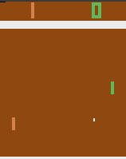
RL vs DRL - Representation of states
RL:
Handcrafted features:
Which features would you use for this?
Notes:
What is a state of the game? How do we represent it? Well, traditionally, this job would be up to the developer of the agent. They would have to figure out which features to use for a game and which to leave out and how to represent those features in their algorithm. When you try to model something, usually, there are many different approaches.
For example, let’s look at Pong. Well, for this game it’s pretty simple, there’s only a handful of things to keep in mind, the player, the enemy, and the ball. Maybe you would include more info, such as distance from one wall or the other, speed of the ball, and so on. Overall, it’s not too hard. Now, let’s look at something else...

Slide 23
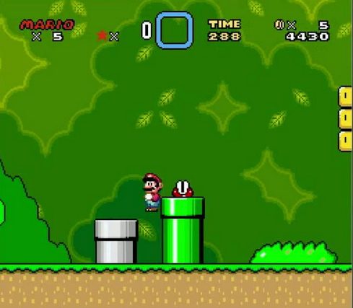
RL vs DRL - Representation of states
RL:
Handcrafted features:
Which features would you use for this?
https://github.com/aleju/mario-ai
Notes:
Here, there are many more concepts to model, and thus also even more ways to model the game. Each way will perform differently. In reinforcement learning, the agent will learn by trial and error. But when modeling a game like this, there’s also a trial and error component for the developer. They’ll have to figure out how to model the game efficiently, and that can take a ton of time already.
To make matters even worse, when doing feature extraction like this, the algorithm will not perform well at all on different games, which is what we’re trying to achieve! So, in DRL, the state representation is done differently:

Slide 24
RL vs DRL - Representation of states
RL:
Many handcrafted features, e.g.:
Pong: location of player and ball
Mario: location of Mario, map? enemies? power up locations? secret tubes?
Tons of time for even simple games.
DRL:
Want something more universal, something that every game uses!
Pixels!
Notes:
See notes previous slide.
We’ll just use pixels as input features. This is something that every game has in common. In deep reinforcement learning, the network will learn features by itself. It will learn which features are important and which are not.

Slide 25
DRL - Representation of state s
Not just raw pixels as input
Preprocessing:
Frames are represented as RGB arrays
Luminance Y from RGB:
2. Resize Y to an 84 x 84 matrix
State s is the result of these transformations!
Notes:
Duidelijk zeggen luminance = grayscale
However, we can’t simply use the raw pixels as input to the network to achieve decent performance. Games’ video frames will go through a bit of preprocessing first.

Slide 26
RL vs DRL - Differences
Differences between standard reinforcement learning and DRL:
Representation of states
Policy function π
Stored data
Notes:
Next, we will discuss the policy function

Slide 27
RL vs DRL - Policy function π
RL:
if π = determined by a table of (state, action) pairs
=> not scalable (memory & sample complexity)
if π = neural network
=> also not scalable for our goal (feature extraction for each game)
DRL:
π = deep neural network for feature extraction and policy function
=> can automatically find compact low-dimensional representation
Notes:
info van deze slides?? http://web.mst.edu/~gosavia/neural_networks_RL.pdf
The most important property of deep learning is that deep neural networks can automatically find compact low-dimensional representations (features) of high-dimensional data (e.g., images, text, and audio)
The true underlying state of the game is contained within 128 bytes of Atari 2600 RAM. However, the DQN was designed to directly learn from visual inputs (210 × 160pixel 8-bit RGB images), which it takes as the state s. It is impractical to represent Qπ (s, a) exactly as a lookup table: When combined with 18 possible actions, we obtain a Qtable of size |S| × |A| = 18 × 2563×210×160. Even if it were feasible to create such a table, it would be sparsely populated, and information gained from one state-action pair cannot be propagated to other state-action pairs. The strength of the DQN lies in its ability to compactly represent both high-dimensional observations and the Q-function using deep neural networks. Without this ability, tackling the discrete Atari domain from raw visual inputs would be impractical.

Slide 28
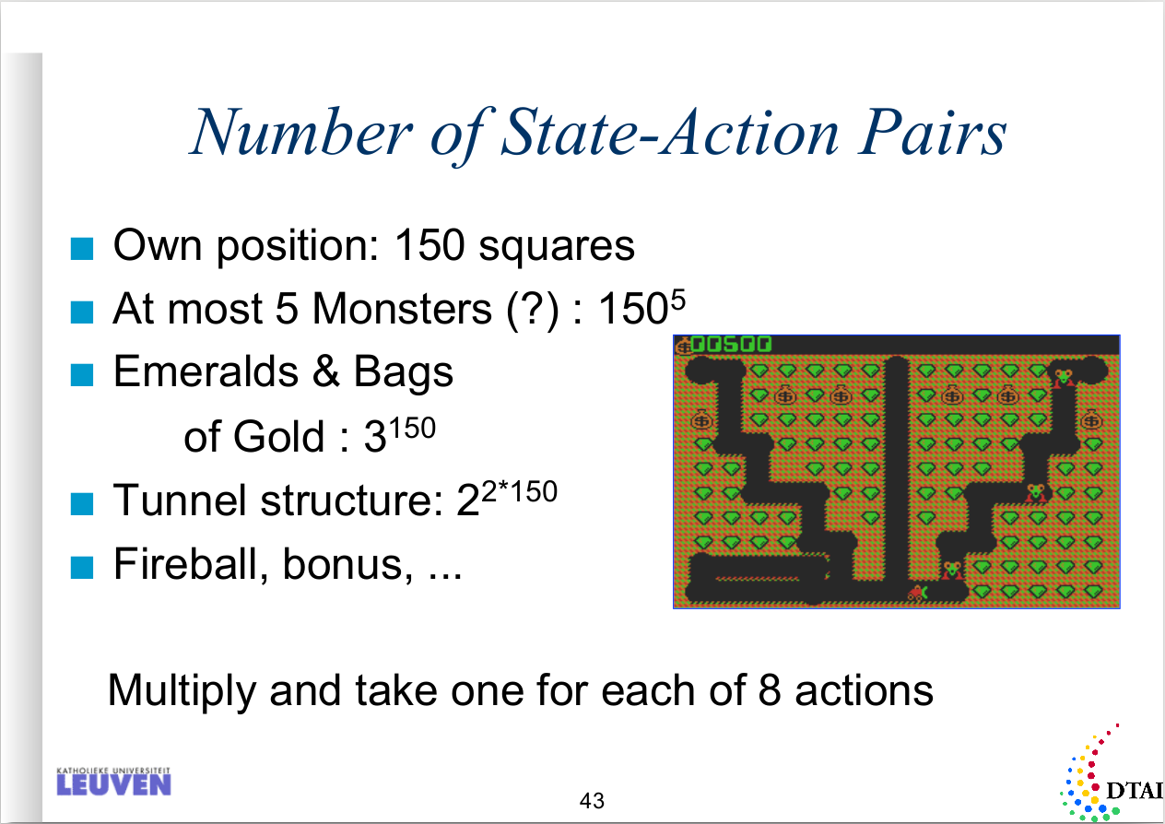
RL vs DRL - Policy function π
If using images:
Image = 210x160 8-bit RGB
|S|
= 256^{210*160*3}
≈ 4 * 10²⁴²⁷⁵⁰
Machine Learning and Inductive Inference, Reinforcement Learning - Hendrik Blockeel
Notes:
Some of you might remember this slide from the machine learning course in the first semester. The professor mentioned the curse of dimensionality here. The size of the Q table exponentially increases in the number of states and actions. The professor mentioned that supervised learning would be a way to solve this problem. What we present today is a different solution!
And just to show another example, let’s say we want to create a table for the images for atari games. The dimensions then are 210 by 160 pixels, with 8 bits for the colours. Even if we could use a table of this size, we would then need to spend an eternity to learn all the values of the table.

Slide 29
RL vs DRL - Differences
Differences between standard reinforcement learning and DRL:
Representation of states
Policy function π
Stored data
Notes:
Finally, we will discuss the data that is stored in DRL

Slide 30
RL vs DRL - Stored data
RL:
A table entry for every possible (state, action) pair or the weights of a NN
DRL:
Store 4-tuples in a list:
Current state s
Action a taken in s
Reward r for taking action a
Clipped to the interval [-1, 1] to make it work for different games.
Next state s’
Such a 4-tuple is called a transition.
Stored inside a replay memory that can hold N transitions.
Notes:
If you do traditional reinforcement learning using a table, then you’ll need to store a table entry for every possible state-action pair. If using a NN to approximate the policy function, then you’ll need to store the NN’s weights.
A new concept in DRL is that you’ll store some extra data apart from the neural network weights. You will store 4-tuples of the following: …
These 4-tuples are called transitions and they will be stored in a replay memory. This memory will hold transitions that gave positive rewards. The replay memory is used to improve training, we will come back to this later.

Slide 31
DRL - Deep Q-Network
Plug in Neural network and problem solved?
NO!
Reinforcement learning caveats when using neural networks:
unstable
can diverge when a nonlinear function approximator such as a neural network is used to represent the policy π
Notes:
So, now we have explained the main points that DRL does differently. However, this is not the end of the story, of course. There are some problems that arise when using neural networks to do reinforcement learning: …
We will explain some tricks Deepmind’s DQN uses to overcome problems.

Slide 32
DRL - Instability
Causes of instability:
Correlations between sequences of frames
If the agent moves one direction on a certain frame, it will often make the same move in the next frame
Feedback loop when updating network
Every step of training, the network’s output shifts
If using a constantly shifting set of output to adjust network weights,
then the output can spiral out of control
Notes:
https://medium.com/@awjuliani/simple-reinforcement-learning-with-tensorflow-part-4-deep-q-networks-and-beyond-8438a3e2b8df
Van paper: Generating the targets using an older set of parameters adds a delay between the time an update to Q is made and the time the update affects the targets y_i, making divergence or oscillations much more unlikely.
Then, they notice how during the training the Q values (predicted by the NN) can change the on going policy, so making the agent prefer only a set of actions and causing it to store data that is correlated for the same reasons as before: this is why they delay training and update Q periodically, to ensure that the agent can explore the game, and train on shuffled and uncorrelated data.

Slide 33
DRL - Reducing instability
Solutions for instability:
Correlations between sequences of frames
  sample transitions uniformly from replay memory
Feedback loop when updating network
  target network = copy of main network
  use target network in loss function
  allow network updates to accumulate
  copy main network over target network periodically
Notes:
periodical updates mitigate effect of feedback loop
DeepMind decided to do it a different way. Instead, we have to fix the weights θ for some number of iterations, and then allow the samples to accumulate. The argument for why this works is a bit hand-wavy and I’m not sure if there exists any rigorous mathematical justification. The DeepMind paper says that this reduces correlations with the target. This is definitely different from the tabular case I just described, where one update immediately modifies targets. If I wanted to make my tabular case the same as DeepMind’s scenario, I would update the weights the normal way, but I would also fix the vector θ−, so that when computing targets only, I would draw from θ− instead of the current θ.

Slide 34
DRL - Preprocessing step
Some more preprocessing before passing to the network:
Stack 4 consecutive states into an 84 x 84 x 4 array
This is 1 sample
Do this 32 times (batch size 32) for random samples
Feed this to the neural network
So… What does the neural network look like?
Notes:
Finally, some more preprocessing was introduced to make the network learn better. Instead of using 1 frame, 4 frames were used at a time.

Slide 35
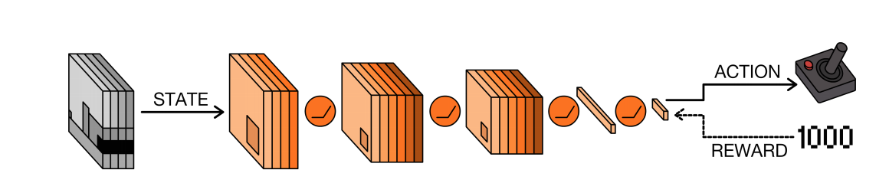
DRL - Deep Q-Network Architecture
Actually the architecture doesn’t matter that much here.
This approach works for small and big networks!
A Brief Survey of Deep Reinforcement Learning, arXiv:1708.05866

Slide 36
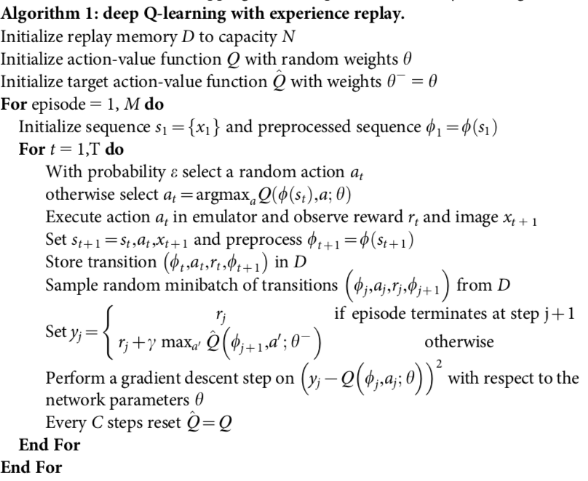
DRL - DQN Code (Summary)
replay memory
policy
target network
preprocess image
store in replay memory
fetch from replay memory
synchronise with target network
Human-level control through deep reinforcement learning, https://www.nature.com/articles/nature14236
Notes:
Hier gewoon de pijltjes overlopen om aan te tonen wat er hier verschillend is vergeleken met normale NN methodes. Al de rest is ni zo belangrijk want iedereen kent Q-learning en NN wel. Misshien gewoon zeggen “en hier gebeurt de gradient descent” zoals bij normale NN ofzo.

Slide 37
Demo!

Slide 38
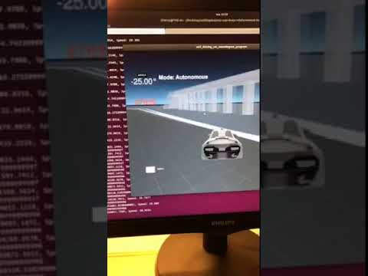
Reward function

Slide 39
DRL - More methods
Dueling Network Architectures
Deep Recurrent Q-Learning (DRQN)

Slide 40
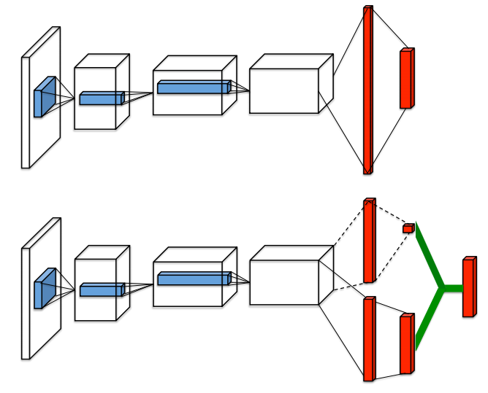
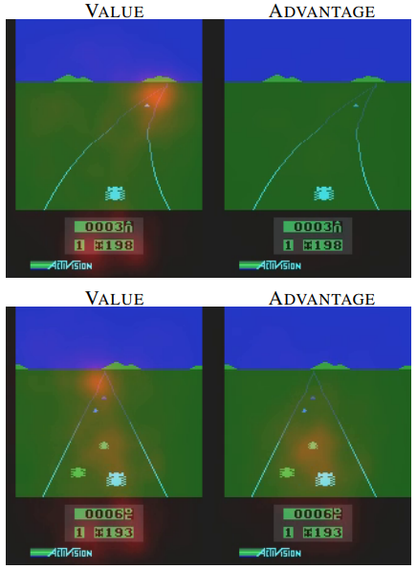
DRL - Dueling Network Architectures
Dueling Network Architectures for Deep Reinforcement Learning, arXiv:1511.06581

Slide 41
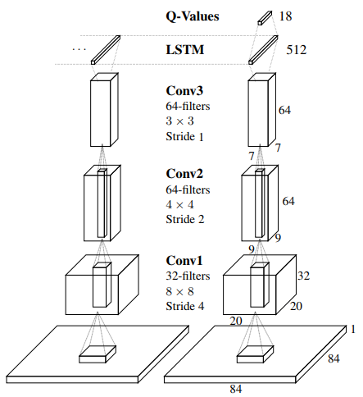
DRL - Deep Recurrent Q-Learning (DRQN)
Deep Recurrent Q-Learning for Partially Observable MDPs, arXiv:1507.06527

Slide 42
DRL - More methods
Many more:
Deep Attention Recurrent Q-Network (DARQN)
Asynchronous advantage actor-critic (A3C)
Generative Adversarial Imitation Learning (GAIL)
Normalized Advantage Function (NAF)
...
Key differences:
Model based <--> Model free
Gradient based <--> Gradient free
Notes:
There are many other methods out there, you can see some of them here. What is important to remember is that there are two key differences between these methods…. model based/free … gradient based/free … examples ...
Examples:
Model based - AlphaGo
Model free - DQN
Gradient based - DQN
Gradient Free - Genetic algorithms

Slide 43
What may come after DRL
Notes:
Als we over tijd zijn dan laten we het gewoon vallen tijdens de presentatie
Wel zeker in het verslag vermelden dat we ons er mee bezig hebben gehouden.

Slide 44
What may come after DRL
How does a human learn? Do we have a reward function?
NO
We are curious and try to explore many different options.

Slide 45
Curiosity reinforcement learning

Slide 46
Curiosity reinforcement learning - How it’s done
Instead of us giving it a reward function, it creates its own reward function.
No need for rewards from the game anymore!
Curiosity-driven Exploration by Self-supervised Prediction, arXiv:1705.05363

Slide 47
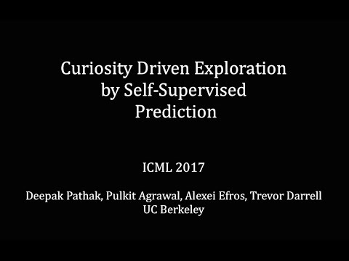
Curiosity reinforcement learning - Example

Slide 48
References
Richard Sutton and Andrew Barto, Reinforcement Learning: An Introduction (1st Edition, 1998)
Human-level control through deep reinforcement learning, https://www.nature.com/articles/nature14236
A Brief Survey of Deep Reinforcement Learning, arXiv:1708.05866
Dueling Network Architectures for Deep Reinforcement Learning, arXiv:1511.06581
Deep Recurrent Q-Learning for Partially Observable MDPs, arXiv:1507.06527
Curiosity-driven Exploration by Self-supervised Prediction, arXiv:1705.05363
Visualizing and Understanding Convolutional Networks, arXiv:1311.2901
Convolutional Neural Networks (CNNs / ConvNets), cs231n.github.io/convolutional-networks/
A Beginner's Guide To Understanding Convolutional Neural Networks, adeshpande3.github.io/A-Beginner%27s-Guide-To-Understanding-Convolutional-Neural-Networks/
Resource Management with Deep Reinforcement Learning, people.csail.mit.edu/hongzi/content/publications/DeepRM-HotNets16.pdf

